Slide 1

Watchdog
Automated System Design
Last Updated: May, 2009

Slide 2
Interactive Features
Play .WAV file via house audio system on the following events:
External Door Open Door_Opened.wav
External Door Close Door_Closed.wav
External Door Unlocked Door_Unlocked.wav
External Door Locked Door_Locked.wav
Garage Door Opened GDoor_Up.wav
Garage Door Closed GDoor_Down.wav
Upstairs Hallway Motion Detected* Motion_Detected.wav
Speak via Windows TTS Synthesizer (MS Mary voice) on the following events:
Mail Delivered “You’ve Got Mail”
Status Check (3 times between 9:30pm “Attention, the following security items must be addressed”
  – 10:00pm) if status is not secure Garage door, Front door lock, Back door lock, Outside door lock, Basement door lock
External door left opened for 1 minute** “Attention, Please close the ??? door”
Greeting upon return to house and open “Welcome Back. While you were gone you missed X Phone
of an external door calls, Y Visitors, and the mail being delivered”.
* Sound only played between the hours of 10PM and 6AM
** Mudroom door waits 3 minutes to allow loading/unloading of the cars

Slide 3
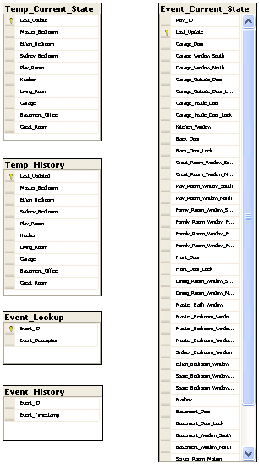
Data Model
Tables:
Temp_Current_State: Holds the most recently read temp values (1 rows)
Temp_History: Holds the last 24 hours of temp values
Event_Current_State: Holds the most recently read house status values (2 rows)
Event_History: Holds 1 month of Event History
Event_Lookup: Static lookup of Event ID values to text
Triggers:
Temp_Current_State_Archive: On Update, Takes the most recently read temp values in Temp_Current_State and inserts them in Temp_History. Also, deletes rows in Temp_History older than 24 hours.
Event_Current_State_Archive: On Update, Takes the changed data from Event_Current_State and inserts a row into Event_History.
Event_History_Purge: On Insert, deletes all the rows older than 1 month.

Slide 4
Reports
SQL Server 2008 Reporting Services
Current Status Report
  Shows the current state of each sensor in the house
  Pulls from Event_Current_State
  Links to Event History Report
Event History Report
  Shows the list of the last 200 events (approx 2 – 3 days)
  Pulls from Event_History
  Links to Current Status Report
Current Temp Report
  Shows the current temp of each sensor in the house
  Pulls from Temp_Current_State
  Links to:
    Garage Temp History Report – Graph
    Kitchen Temp History Report – Graph
    Playroom Temp History Report – Graph
    Living Room Temp History Report – Graph
    Master Bedroom Temp History Report – Graph
    Sydney’s Bedroom Temp History Report – Graph
    Ethan’s Bedroom Temp History Report - Graph

Slide 5
Module Overview
10011010
01111000
WDPlay_Voice
WDHouseUpdate
SQL Server 2008
Reporting
Services
Watchdog
WDTempUpdate
WDPlay_Sound
SQL Server 2008
Express Ed.
10011010
01111000
Reporting Service Sites:
User: http://192.168.1.202/ReportServer_WATCHDOG/
Admin: http://192.168.1.202:8080/Reports_WATCHDOG/Pages/Folder.aspx

Slide 6
Temp Sensor Connections
Board #1:
Measurement Computing USB-TEMP
 | Sensor
0 | Server Room
1 | Garage
2 | Kitchen
3 | Play Room
4 | Living Room
5 | Master Bedroom
6 | Sydney’s Bedroom
7 | Ethan’s Bedroom

Slide 7
DIO Sensor Connections
Board #2:
Measurement Computing USB-1024LS
A | Sensor | B | Sensor | C | Sensor
0 | Kitchen Window | 0 | Living Room Front S | 0 | Mudroom Door Lock
1 | Back Door | 1 | Living Room Front C | 1 | Garage Window N
2 | Back Door Lock | 2 | Living Room Front N | 2 | Garage Window S
3 | Great Room Window N | 3 | Front Door | 3 | Garage Door
4 | Great Room Window S | 4 | Front Door Lock | 4 | Garage Outside Door
5 | Play Room Window N | 5 | Dining Room Window S | 5 | Garage Outside Door Lock
6 | Play Room Window S | 6 | Dining Room Window N | 6 | Mailbox
7 | Living Room Window S | 7 | Mudroom Door | 7
Board #3:
Measurement Computing USB-1024LS
A | Sensor | B | Sensor | C | Sensor
0 | Master Bath Window | 0 | Basement Door | 0 | Telephone
1 | MBR Window S | 1 | Basement Door Lock | 1 | Car West
2 | MBR Window Back S | 2 | Basement Window S | 2 | Car East
3 | MBR Window Back N | 3 | Basement Window N | 3
4 | Sydney BR Window | 4 | Upstairs Hall Motion | 4
5 | Ethan BR Window | 5 | Server Room Motion | 5
6 | Spare BR Window N | 6 | Great Room Motion | 6
7 | Spare BR Window S | 7 | Doorbell | 7

Slide 8
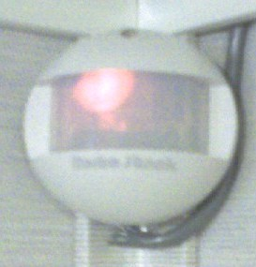
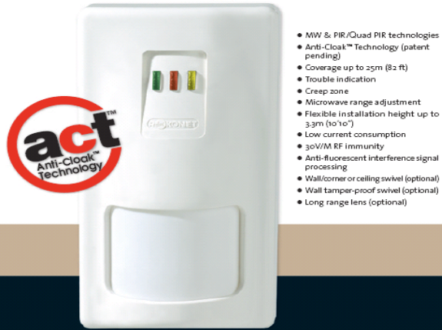
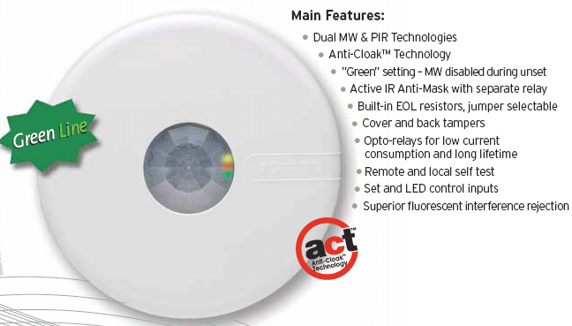
Motion Sensors
Server Room Motion Sensor:
Radio Shack 49-208
180° Passive Infrared Motion Sensor
Great Room Motion Sensor:
Roconet iWise DT-Quad
Mid-range (50’) model
Dual technology (Microwave, Infrared), Dual element
Anti-Cloak Technology
Upstairs Hallway Motion Sensor:
Roconet LuNAR DT - Ceiling Mount
Dual technology (Microwave, Infrared)
360° coverage
Anti-Cloak Technology

Slide 9
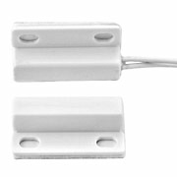
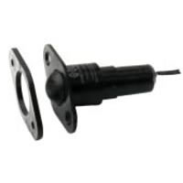
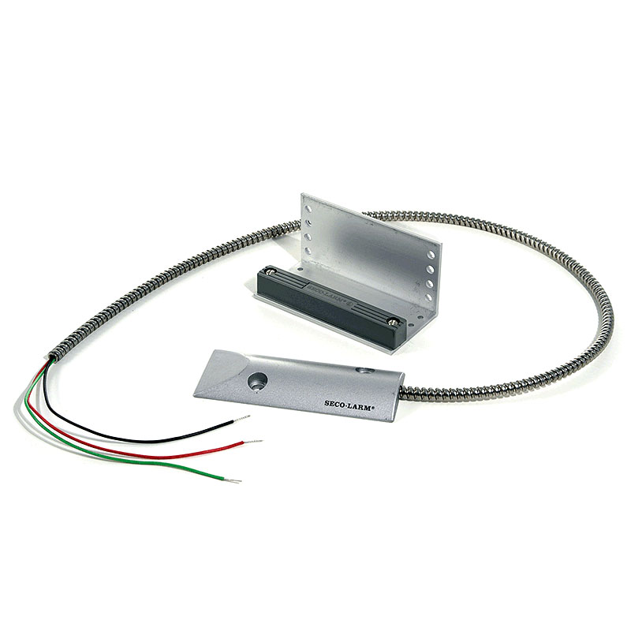
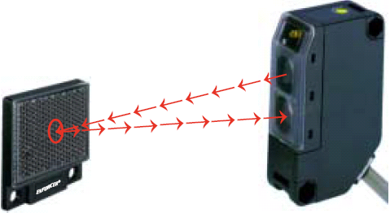
Other Sensors
Window Sensors:
Honeywell MPS-45WG
Sub-mini surface mount magnetic contact with exit leads
Door Sensor:
Roller Ball / Plunger Contact switch
Garage Door Sensor:
Seco-Larm ODC-59A
Magnetic
Car Park Sensor:
Seco-Larm Enforcer E-931-S35RR
Retroreflective Photoelectric Sensor

Slide 10
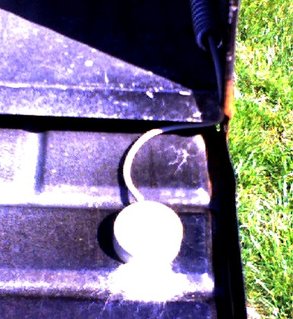
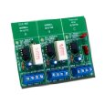
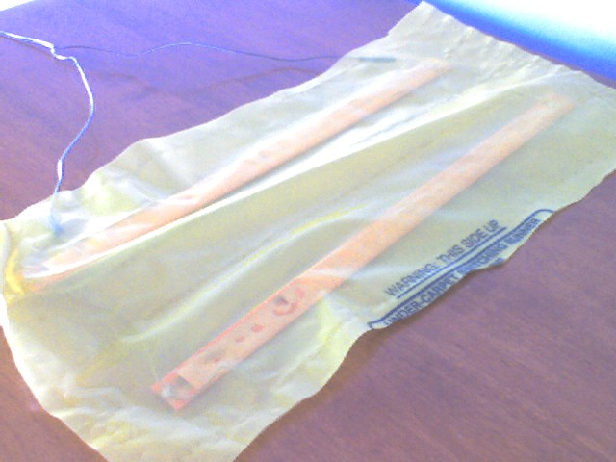
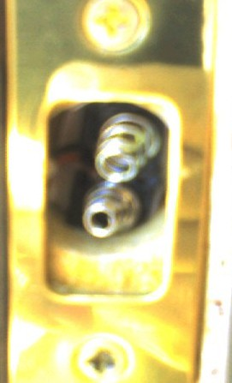
Other Sensors
Mailbox Sensor:
Enclosed mercury tilt switch
Doorbell & Telephone Sensor
ELK Doorbell & Telephone Ring Detector ELK-930
2 Telephone 1ines, 1 doorbell; Relay switch
Stair Sensor:
Weight sensor bars
Door Lock Sensor:
Custom deadbolt contact sensor with metal springs

Slide 11
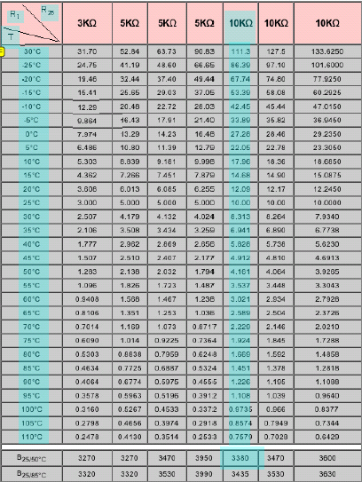


Temp Sensors
Cantherm Thermistor 10KΏ
Steinhart-hart equation for determining co-efficients:
Calculation:
A = 0.000545
B = 0.000305
C = 0

Slide 12
Event Codes
2001 | Garage Door Open
2002 | Garage Door Closed
2003 | Garage Window South Open
2004 | Garage Window South Closed
2005 | Garage Window North Open
2006 | Garage Window North Closed
2007 | Garage Outside Door Open
2008 | Garage Outside Door Closed
2009 | Garage Outside Locked
2010 | Garage Outside Unlocked
2011 | Garage Inside Door Open
2012 | Garage Inside Door Closed
2013 | Garage Inside Unlocked
2014 | Garage Inside Locked
2015 | Kitchen Window Open
2016 | Kitchen Window Closed
2017 | Back Door Open
2018 | Back Door Closed
2019 | Back Door Unlocked
2020 | Back Door Locked
2021 | Great Room Window North Open
2022 | Great Room Window North Closed
2023 | Great Room Window South Open
2024 | Great Room Window South Closed
2025 | Play Room Window North Open
2026 | Play Room Window North Closed
2027 | Play Room Window South Open
2028 | Play Room Window South Closed
2029 | Family Room Window South Open
2030 | Family Room Window South Closed
2031 | Family Room Window Front South Open
2032 | Family Room Window Front South Closed
2033 | Family Room Window Front Middle Open
2034 | Family Room Window Front Middle Closed
2035 | Family Room Window Front North Open
2036 | Family Room Window Front North Closed
2037 | Front Door Open
2038 | Front Door Closed
2039 | Front Door Unlocked
2040 | Front Door Locked
2041 | Dining Room Window South Open
2042 | Dining Room Window South Closed
2043 | Dining Room Window North Open
2044 | Dining Room Window North Closed

Slide 13
Event Codes
1001 | Basement Door Open
1002 | Basement Door Closed
1003 | Basement Door Unlocked
1004 | Basement Door Locked
1005 | Basement South Window Opened
1006 | Basement South Window Closed
1007 | Basement North Window Opened
1008 | Basement North Window Closed
5000 | Mail State Reset
5001 | Mail Delivered
5002 | Mail Retrieved
5003 | Doorbell Rang
5004 | Telephone Rang
5005 | Moms Car Arrived
5006 | Moms Car Departed
5007 | Dads Car Arrived
5008 | Dads Car Departed
6001 | Motion Detected in Server Room
6002 | Motion Detected in Upstairs Hallway
6003 | Motion Detected in Great Room
9001 | WDHouseUpdate Started
9002 | WDHouseUpdate Stopped
9003 | WDTempUpdate Started
9004 | WDTempUpdate Started
9999 | Error
3001 | Master Bath Window Open
3002 | Master Bath Window Closed
3003 | Master Bedroom Window Back South Open
3004 | Master Bedroom Window Back South Closed
3005 | Master Bedroom Window Back North Open
3006 | Master Bedroom Window Back North Closed
3007 | Master Bedroom Window South Open
3008 | Master Bedroom Window South Closed
3009 | Guest Bedroom Window 1 Open
3010 | Guest Bedroom Window 1 Closed
3011 | Guest Bedroom Window 2 Open
3012 | Guest Bedroom Window 2 Closed
3013 | Ethan Bedroom Window Open
3014 | Ethan Bedroom Window Closed
3015 | Sydney Bedroom Window Open
3016 | Sydney Bedroom Window Closed

